Slide 1
Final Document Preparation
Final Year Project
FOR ALL FYPs – COMPUTING & TECHNOLOGY

Slide 2
You should remember, it does not matter how brilliant your work is if it is not communicated.

Slide 3
Poor writing will undermine your authority in the reader’s eyes, and good writing will strengthen it.

Slide 4
You should remember that you should always write to be understood, not to impress!

Slide 5
The TRUTH !
Significant marks are awarded based on the
documentation.
Give an equal important to both ( your final documentation & end product of your FYP (system) ).
Internal and External moderators for projects
usually ONLY look at your documentation
when they moderate projects.
Paying attention to your FYP documentation is
perhaps a sensible way to attain the best
possible grade for yourself.

Slide 6
Learning Outcomes
At the end of this session, YOU should be able to:
explain the requirements of the documentation
explain the structure of the documentation
identify and apply references within project

Slide 7
Requirements of the Documentation
Concise
Precise
Focused
Clear
Properly Typeset
Well Structured
Well Written

Slide 8
STRUCTURE OF THE FINAL DOCUMENTATION
Title Page / Cover Page
Acknowledgement (optional)
Abstract
Table of Contents
CHAPTER 1: INTRODUCTION TO THE STUDY (semester 1)
CHAPTER 2: LITERATURE REVIEW (semester 1)
CHAPTER 3: TECHNICAL RESEARCH (semester 1)
CHAPTER 4: SYSTEM DEVELOPMENT METHODOLOGY (semester 1)
CHAPTER 5: RESEARCH METHODS (semester 1)
CHAPTER 6: REQUIREMENTS VALIDATION (ANALYSIS) (semester 1)
CHAPTER 7: SYSTEM ARCHITECTURE (semester 2)
CHAPTER 8: PROJECT PLAN (semester 2)
CHAPTER 9: IMPLEMENTATION (semester 2)
CHAPTER 10: SYSTEM VALIDATION (semester 2)
CHAPTER 11: CONCLUSIONS AND REFLECTIONS
REFERENCES
APPENDICES

Slide 9
Title Page/Cover Page
Please refer to the project zip file received from your Project manager.

Slide 10
CHAPTER 1: INTRODUCTION TO THE STUDY
A good documentation requires a good introduction
which sets a scene by putting the developed system
in a bigger perspective.
Introduction contains some of the following elements:
Background to the project
Problem context / Problem statements
Rationale
Potential benefits
Target Users
Aims
Objectives of System
Deliverables / Functionality of System
Nature of Challenges
Overview of this report (final doc)
Project Plan (IR & final)

Slide 11
CHAPTER 2: LITERATURE REVIEW
This chapter describes and discuss the domain research conducted .
Materials should be from academic publications, journals, conference proceedings and books as far as which is necessary in order to understand the solution.
Introduction
Domain Research
Similar System/s (with similar features) - A minimum of 3 with illustration - A picture is worth a thousand words
Summary

Slide 12
CHAPTER 3: TECHNICAL RESEARCH
This chapter describes and discuss the technical research conducted.
3.1: Programming language chosen (Provide at least three (3) for comparison purpose) - (Optional)
3.2: IDE (Interactive Development Environment) chosen
3.3: libraries chosen / Tools chosen (Optional)
3.4: Database Management System chosen (Provide at least three (3) for comparison purpose) – (Optional)
3.5: Operating System chosen
3.6: Web Server chosen (Optional)
3.7: Web browser chosen (Optional)
3.8 Techniques chosen / Algorithms chosen (Optional)
3.9: Summary

Slide 13
CHAPTER 4: SYSTEM DEVELOPMENT METHODOLOGY
Identify the system development methodology you have chosen
Justify your selection
Describe the system development methodology
Give an overview of the diagrams associated with the methodology
Give a brief overview of how this project will proceed
(Select the right system development methodology)

Slide 14
CHAPTER 5: RESEARCH METHODS
This chapter reveals the approach of Primary Research that was conducted by the developer. For example :-
Observation
Interview
Questionnaire
Focus group
5.1: Introduction
5.2: Design
5.3 Summary

Slide 15
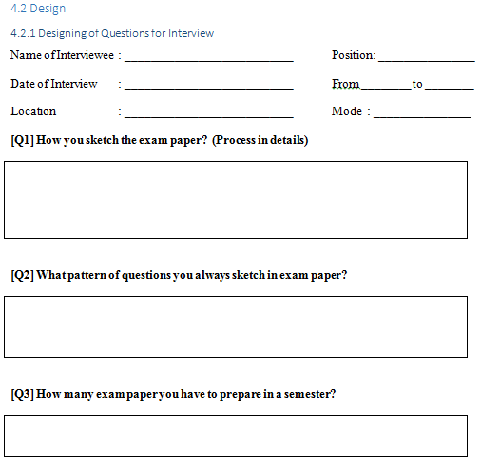
Designing of Interview Questions

Slide 16
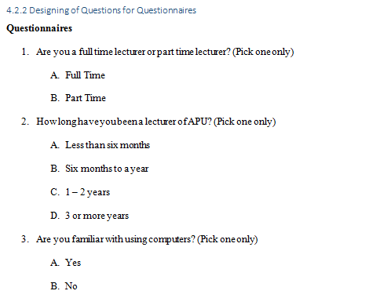
Designing of Questionnaire

Slide 17
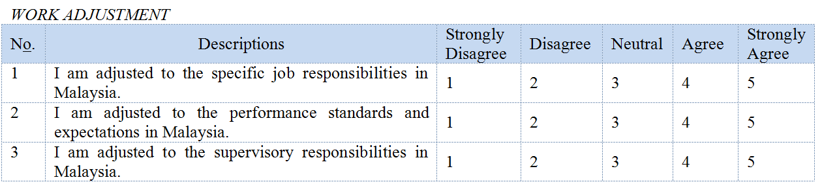
Designing of Questionnaire

Slide 18
CHAPTER 6: REQUIREMENTS VALIDATION (ANALYSIS)
6.1 Analysis of Data
6.1.1: Analysis of data collected through Questionnaire (if you have collected research data using this method)
6.1.2 Analysis of data collected through Interview (if you have collected research data using this method)
6.1.3 Analysis of data collected through Observation (if you have collected research data using this method)
6.2 Summary

Slide 19
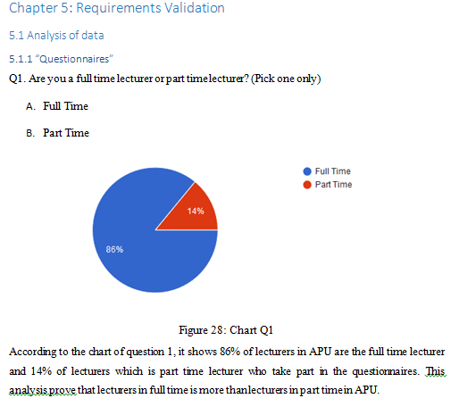
Analysis of data

Slide 20
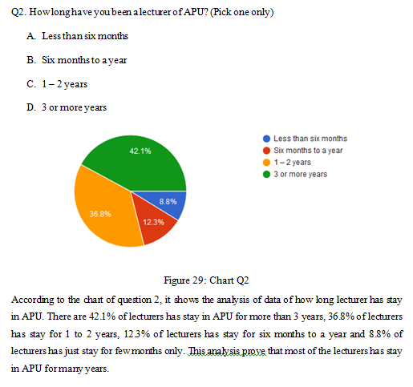
Analysis of data

Slide 21
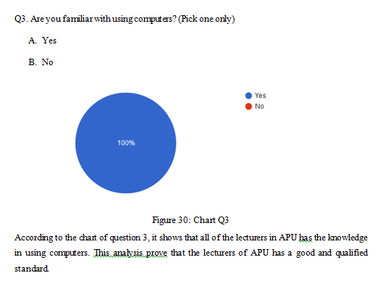
Analysis of data

Slide 22
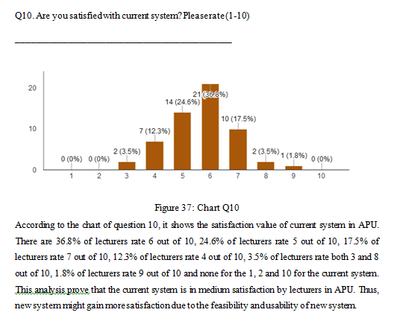
Analysis of data

Slide 23
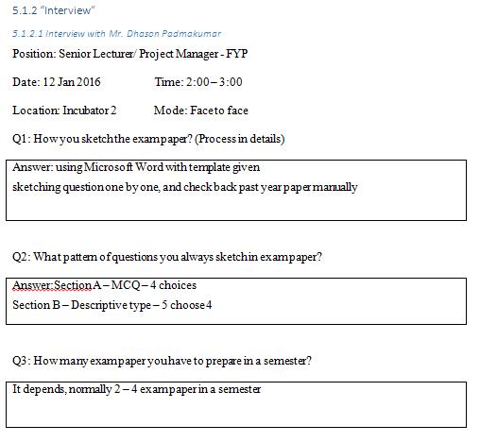
Analysis of Data

Slide 24
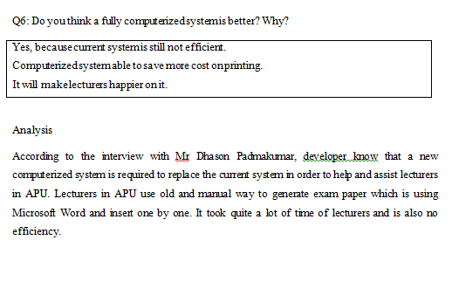
Analysis of data

Slide 25
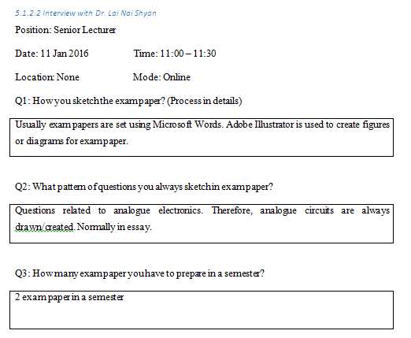
Analysis of data

Slide 26
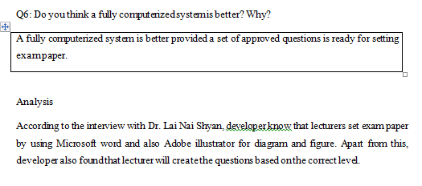
Analysis of data

Slide 27
Conclusion (for the chapter Analysis)
What was achieved at the end of the first leg (Investigation) of the project?
Were you able to do enough investigation / research with regards to what you want to achieve?
Were there any gaps in your research and design – areas where you may want to further explore and improve?

Slide 28
CHAPTER 7: SYSTEM ARCHITECTURE
7.1: Introduction
Describe the core features and elements of the system
Paragraph by paragraph
(1 - 2 pages)

Slide 29
CHAPTER 7: SYSTEM ARCHITECTURE
7.2 Abstract Architecture
7.2.1: System design (it should be very detailed)
use-case diagram
use-case specification
class-diagram
activity-diagram
sequence diagram
Or
Context diagram
DFD – Level 0
DFD Level 1

Slide 30
CHAPTER 7: SYSTEM ARCHITECTURE
7.2.2: Database design
(Ignore this section, if your FYP does not require any DBMS)
7.2.2.1: Entity relationship diagram (ERD)
7.2.2.2: Database table structure(Database Scheme)

Slide 31
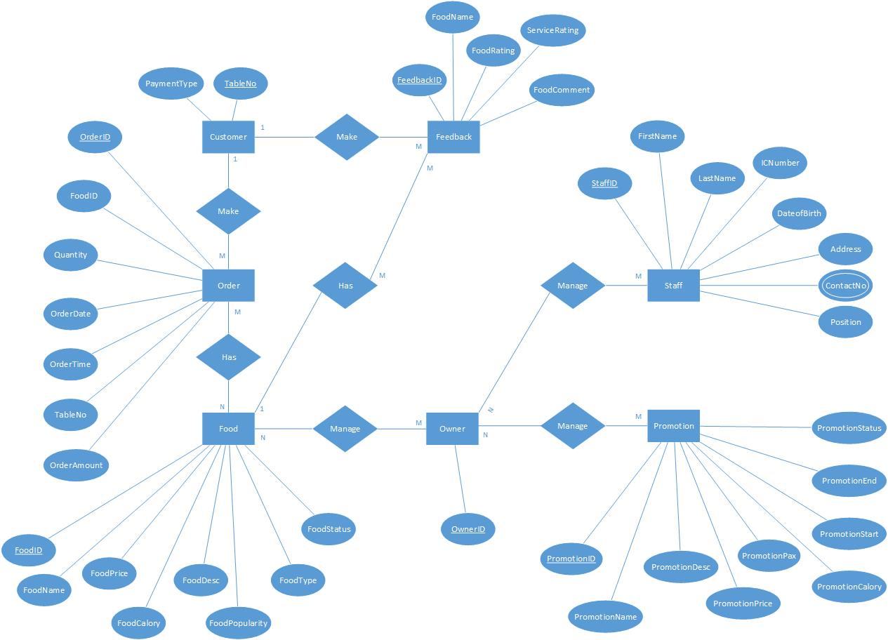
CHAPTER 7: SYSTEM ARCHITECTURE
Entity relationship diagram (ERD) - Sample

Slide 32
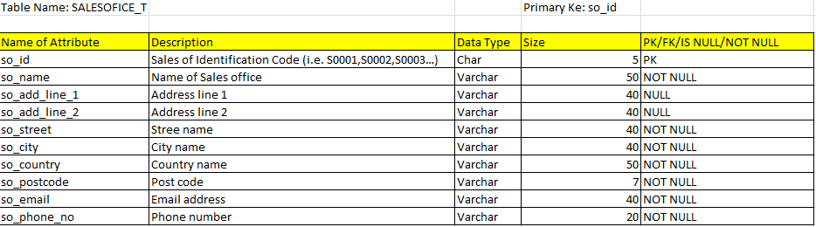
CHAPTER 7: SYSTEM ARCHITECTURE
Database table structure (Database Schema)

Slide 33
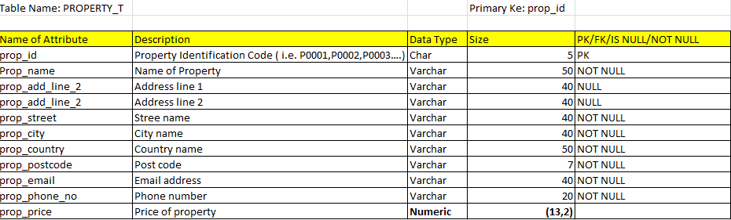
CHAPTER 7: SYSTEM ARCHITECTURE
Database table structure (Database Schema)

Slide 34
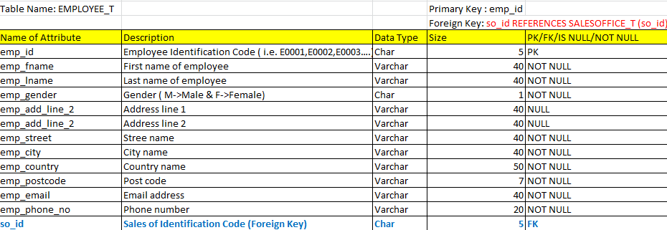
CHAPTER 7: SYSTEM ARCHITECTURE
Database table structure (Database Schema)

Slide 35
CHAPTER 7: SYSTEM ARCHITECTURE
7.2.3. Interface design (storyboard)
should be documented very detailed
use either an appropriate tool
MS Paint
Pencil - http://pencil.evolus.vn/)

Slide 36
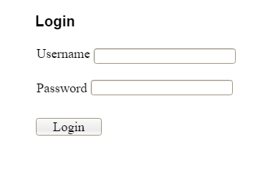
7.2.3.1 Interface for Login.aspx
CHAPTER 7: SYSTEM ARCHITECTURE
Interface design (storyboard)

Slide 37
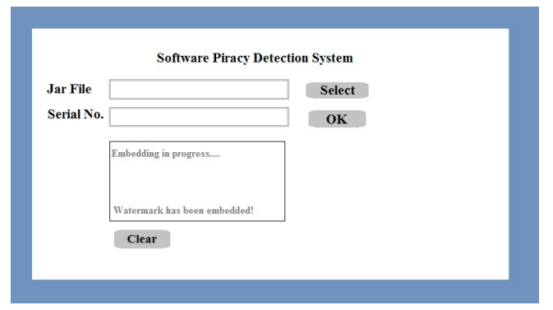
CHAPTER 7: SYSTEM ARCHITECTURE
Interface design (storyboard)
Interface to upload file i.e. upload.php (example)

Slide 38
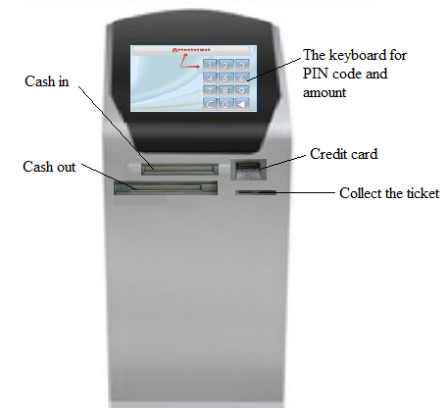
CHAPTER 7: SYSTEM ARCHITECTURE
Interface design (storyboard)
Customer Interface Design (for the Kiosk machine):
Description:
This is kiosk machine, which will be located not far from the cinemas, through which customers can purchase movie tickets. Further, using these machine customers can top up RFID card. The machine will have four slots, the first slot will allow the consumer to use the credit card for the purchase the ticket, the second slot allows to buy a ticket by using cash, a third slot for the cash out and fourth slot will issue a ticket based on paper if the client does not have RFID-cards.

Slide 39

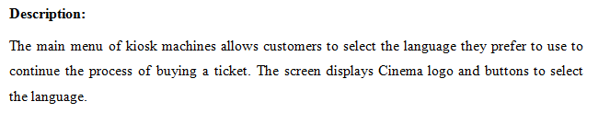
CHAPTER 7: SYSTEM ARCHITECTURE
Interface design (storyboard)
Main Menu:

Slide 40
CHAPTER 8: PROJECT PLAN
8.1 Details of the release plan
8.1.1 Version 1.0 of your project title
The version 1.0 of your project will be released in the first week of Aug-2017. That release would have the following functions, which includes ….
8.1.2 Version 2.0 of your project title
The version 2.0 of your project will be released in the 2nd week of Aug-2017. That release would have the following functions, which includes ….

Slide 41
CHAPTER 8: PROJECT PLAN
8.2 Test Plan
Describe your test-driven development strategy
8.2.1 Test plan for unit testing
8.2.2 Test plan for User Acceptance Testing

Slide 42
CHAPTER 8: PROJECT PLAN
8.2 Test plan for unit testing
8.2..1 Logon.aspx
ID | Test Case | Expected Result | Actual Result | Pass/Fail
1.1 | Leave Username box empty. Leave Password box empty. Click ‘Login’ button. | “The username field is required” is displayed. “The password field is required” is displayed.
1.2 | Input valid username. Leave Password box empty. Click ‘Login’ button. | “The password field is required” is displayed.
1.3 | Input invalid username. Leave Password box empty. Click ‘Login’ button. | “The password field is required” is displayed.
1.4 | Leave Username box empty. Input password. Click ‘Login’ button. | “The username field is required” is displayed.

Slide 43
CHAPTER 8: PROJECT PLAN
8.2.2 ChangePassword.aspx
8.2 Test Plan
ID | Test Case | Expected Result | Actual Result | Pass/Fail
9.1 | Leave the “Current password” field blank. Leave the “New password” field blank. Leave the “Confirm new password” field blank. | “The current password field is required.” is displayed. “The new password is required.” is displayed. “Confirm new password is required.” is displayed.
9.2 | Input current password. Leave the “New password” field blank. Leave the “Confirm new password” field blank. | “The new password is required.” is displayed. “Confirm new password is required.” is displayed.
9.3 | Leave the “Current password” field blank. Input new password. Leave the “Confirm new password” field blank. | “The current password field is required.” is displayed. “Confirm new password is required.” is displayed.

Slide 44
CHAPTER 8: PROJECT PLAN
Prepare test plans (test cases) for each form/functions

Slide 45
CHAPTER 8: PROJECT PLAN
8.2 Test plan for User Acceptance Testing
Tester Name :____________________________________________
Job Position :____________________________________________
Date :____________________________________________
Start Time :___________________ End Time:____________________
Legend: 0-Poor, 5-Excellent
 | 0 | 1 | 2 | 3 | 4 | 5
User Interface
Meeting objectives
Security
Bug-free
Input validation
Easy to use
Feedback From the Tester
Comments:
Action taken by the developer:

Slide 46
CHAPTER 9: IMPLEMENTATION
9.1 Screenshots
(Should be very detailed. 2 screenshots per page and do it for all important forms or pages)
9.1.1 Screenshots for i.e. home page (home.aspx) 9.1.1.1 Description
9.1.1.2 Screenshot
9.1.2 Screenshot for sign-in page (sign-in.aspx)
9.1.2.1 Description
9.1.2.2 Screenshot
9.1.3 Screenshot for sign-out page (sign-out.aspx) 9.1.3.1 Description
9.1.3.2 Screenshot

Slide 47
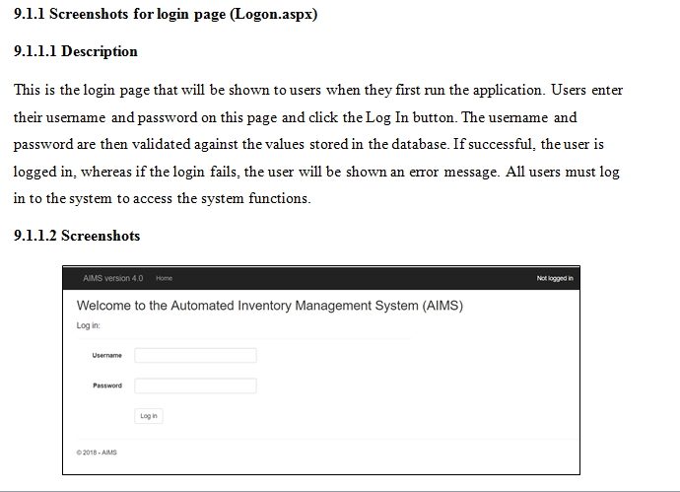
CHAPTER 9: IMPLEMENTATION

Slide 48
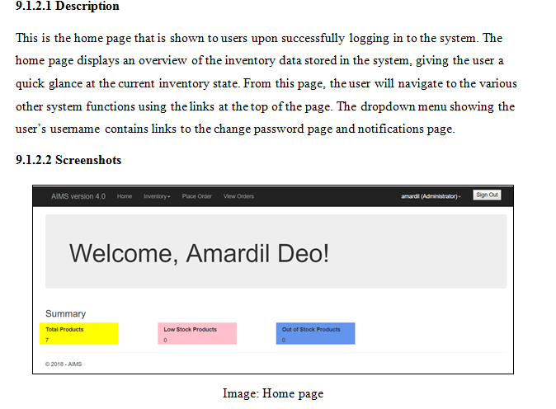
CHAPTER 9: IMPLEMENTATION

Slide 49
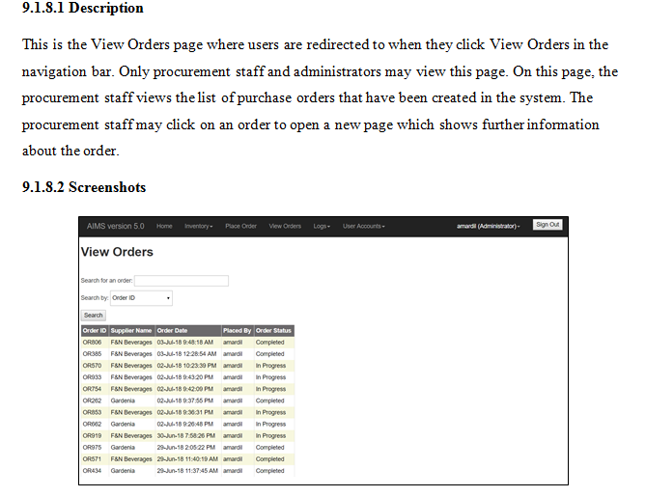
CHAPTER 9: IMPLEMENTATION

Slide 50
CHAPTER 9: IMPLEMENTATION
9.2 Sample codes (at least for 3 programs)
9.2.1 Sample codes written for i.e. sign-in.aspx
9.2.2 Sample codes written for sign-up.aspx
9.2.3 Sample codes written for sign-out.aspx

Slide 51
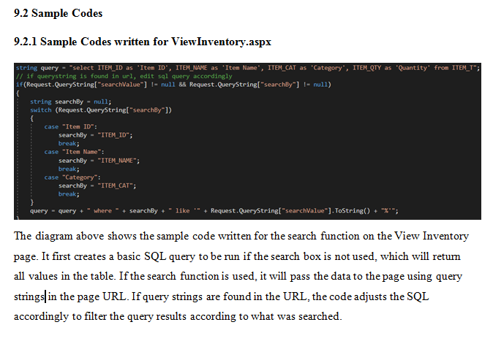
CHAPTER 9: IMPLEMENTATION

Slide 52
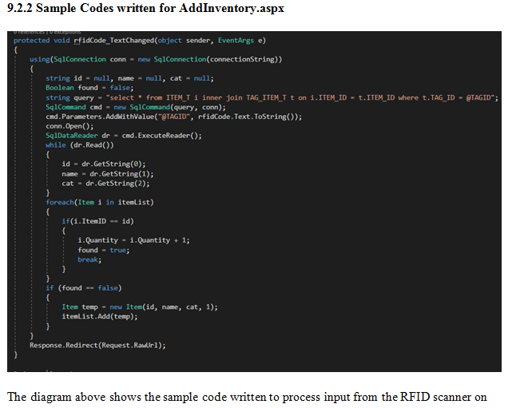
CHAPTER 9: IMPLEMENTATION

Slide 53
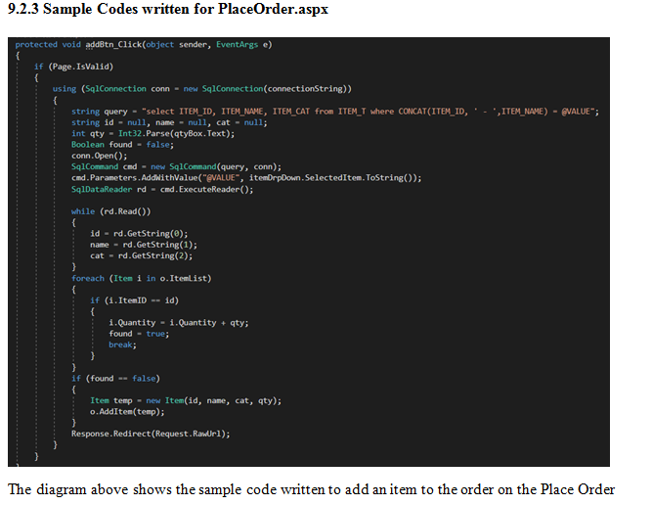
CHAPTER 9: IMPLEMENTATION

Slide 54
CHAPTER 10: SYSTEM VALIDATION
This chapter documents outcomes of various tests that were
conducted during the duration of development. The chapter
should highlight :-
10.1: Unit testing (very detailed and do it for all programs)
10.1.1 i.e. sign-in.php
10.1.2 i.e. sign-out.php
10.1.3
10.2: User acceptance testing ( minimum of 3 right users should have tested your systems)
10.4: Summary

Slide 55
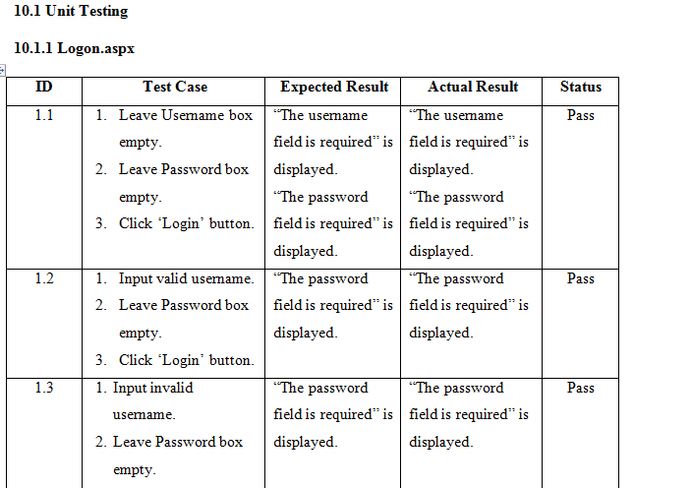
CHAPTER 10: SYSTEM VALIDATION

Slide 56
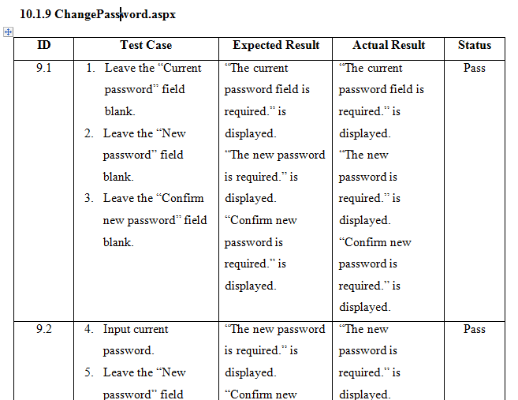
CHAPTER 10: SYSTEM VALIDATION

Slide 57
CHAPTER 10: SYSTEM VALIDATION
10.2 User Acceptance Testing
10.2.1 Outcome of testing by Au Zheng Yee
Tester Name : Au Zheng Yee
Job Position : Former Data Entry Worker at Popular Bookstores
Date : 29/06/2018
Start Time : 4.00 p.m. End Time : 5.00 p.m.
Legend: 0-Poor, 5-Excellent
 | 0 | 1 | 2 | 3 | 4 | 5
User Interface |  |  |  |  |  | X
Meeting objectives |  |  |  | X
Security |  |  |  | X
Bug-free |  |  |  | X
Input validation |  |  |  |  |  | X
Easy to use |  |  |  | X
Feedback From the Tester
Comments: Search functions on the view inventory and view order pages can be improved. Text boxes on edit inventory page are too big. Quantity box should not accept negative numbers. Alignment of add button on place order page is off
Action taken by the developer: The search functions on the View Inventory and View Order pages was upgraded to allow the user to search by typing a few letters instead of the full name (for example, searching “br” brings up all items starting with “br”). The text boxes on the Edit Inventory page were resized to fit the content. Validation was added for the Quantity box on the Edit Inventory page. The Add button on the Place Order page was relocated next to the Select Supplier dropdown box.

Slide 58
CHAPTER 11: CONCLUSIONS AND REFLECTIONS
Contains two chapters :-
Critical Evaluation ( 1.5 ~ 2 pages )
Conclusion (1 page )

Slide 59
Critical Evaluation
This chapter detail out the benefit of the system
that had been developed. In other words, explain how
useful is the system to the targeted end-user.

Slide 60
Conclusion
This conclusion is the last chapter of the documentation.
This chapter should include details on:
whether the system solved the problem it was suppose to
the limitations and errors in the developed system
possible future enhancement
what would you have done differently if you were given
the time to redo the project
the main computational challenge in your system
the learning experience gathered

Slide 61
References
You are expected to acknowledge any material in books etc that you have used in reports/dissertations etc
Harvard style of referencing must be used.
Madden, R & Hogan, T 1997, The definition of disability in Australia: moving towards national consistency, Australian Institute of Health and Welfare, Canberra

Slide 62
Bibliography
A Bibliography is any list of references at the end of a text, whether cited or not. It includes texts you made use of, not only texts you referred to in your paper, but your own additional background reading, and any other articles you think the reader might need as background reading.
Cuba, L. 1988, A Short Guide to Writing in the Social Sciences.
London: Scott Foresman.Chs. 2, 4 & 6.
Friedman, S. & S. Steinberg 1989, Writing and thinking in the
Social Sciences.Englewood Cliffs, NJ: Prentice Hall.
Hamp-Lyons, L. & K. Courter 1984, Research matters. Rowley,
Mass.: Newbury House.

Slide 63
Appendices
This section should contain all the materials below:
FYP Poster - A3 size (colour) - fold it and attach it to softbound document.
Meeting log sheets (a minimum of 6 log meeting sheets)
PPF (Photostat copy)
PSF (Photostat copy)
Ethics form (Photostat copy)
Gantt chart for the whole FYP (detailed)

Slide 64
What should be submitted to Moodle?
FYP doc in PDF
End product of your FYP (complete source codes)
FYP in 5 ~ 7 minutes video (use SNAGIT or any screen capture software)

Slide 65
What should be in hardbound doc?
Similar in contents as with online FYP doc submission.
Need not to attach a CD to your hardbound doc.
Submit your hardbound FYP doc at Admin counter in level 4, Block D,APU or send your hardbound FYP doc to FYP department by a registered post within 1-month from the date of online FYP doc submission.

Slide 66
Number of Pages and Volume
10,000 words or total number of pages including appendices should not exceed 200 pages
The report must be laser-printed or high-quality-printed on A4-size paper with a weight between 70 and 100g/m2 and should be on the right-hand (i.e. recto) page with a left margin of 40-50mm and other margins of 15-20mm

Slide 67
Volumes
Do not place too many documents under Appendices.
Remember that the Appendices will not be looked at unless and a reference is made to it in the main documentation.
Diagrams and write-ups that don’t add value to the project should either be placed in the appendices or not included at all.
Failing to comply on the above will result in deduction of marks

Slide 68
Writing Prose
The use of “I” should is not allowed for an academic report. Instead the word “developer” should be used.
Example:
The developer has decided to use ASP.NET as the choice of programming language due to the following reasons:

Slide 69
General Hint
For most sections write about:
- What you have done ?
- Why you have done the way you have done?
- How you have done?
Write what the examiners would like to know (your findings, conclusions and critical insights) and less about what they already know (discussion on technology, tools and programming languages)

Slide 70
General Hint
Backups !!!
EC application rejection treated as 2nd attempt.
The EC committee will not accept ;
PC crash – how ever genuine it may be!!
For accidents (police report to be furnished)
It is poor project management to say that you could not submit because you were NOT WELL!!
In any case an EC should be submitted!

Slide 71
Extenuating Circumstances
Request for extensions of FYP submission date will not be entertained except for extenuating circumstance. This is defined as events beyond your control.

Slide 72
FYP Presentation
If you fail to turn up for your presentation 3 times, your project will only be marked based on your FYP documentation.

Slide 73
The best researchers spend significant time making sure their presentation [documentation] is excellent, often rewriting sentences and paragraphs numerous times before they are satisfied !
Berndtsson, M. et. al, 2002. Planning and Implementing your Final Year Project with Success! – A Guide for Students in Computer Science and Information Systems, Springer

Slide 74
IMPORTANT CHECKLIST !!
Before you think you have completed your documentation, ask yourself the following questions:
Have all aspects of my project been documented
including implementation – Have I said what I wanted to say?
Does my documentation convey all the work I have
done? – Did I miss out anything?
Can anyone understand my project in its entirety by just
looking at my documentation? – Can my documentation speak for me?
Have my documentation been completely referenced?
Have I proof-read my work – check for grammar and use
of appropriate language?
Did I show and discuss my finalised documentation and system
with my supervisor prior to submission?

Slide 75
Question and Answer Session
Q & A

Slide 76
Good Luck !

